Slide 1
The Future’s Shiny:
Dashboards for Pioneering Genomic Medicine in R
Notes:
1:30 [1:30/20:00]
Thank you all for coming along to my talk.
I’m Nic Crane and I work for a company called Elucidata. We’re a data science and software development company, and we’re currently working with Genomics England on some really exciting projects. The project I’m going to be talking to you about today is the first half of a bigger project which involves Shiny, and it’s a project I’m really excited to have been part of, with really tangible real-world applications.
A bit more info about me then; I’ve been working with R on and off for about 8 years, and I’ve been developing Shiny apps full time for about 18 months now, which has been really fun and interesting.
I’d like to start by getting a show of hands; who here has heard of the Hundred Thousand Genome Project?
OK, so some of you have and some haven’t.
I’m going to start by telling you a quick story about one of the participants in this project, to provide some context.

Slide 2
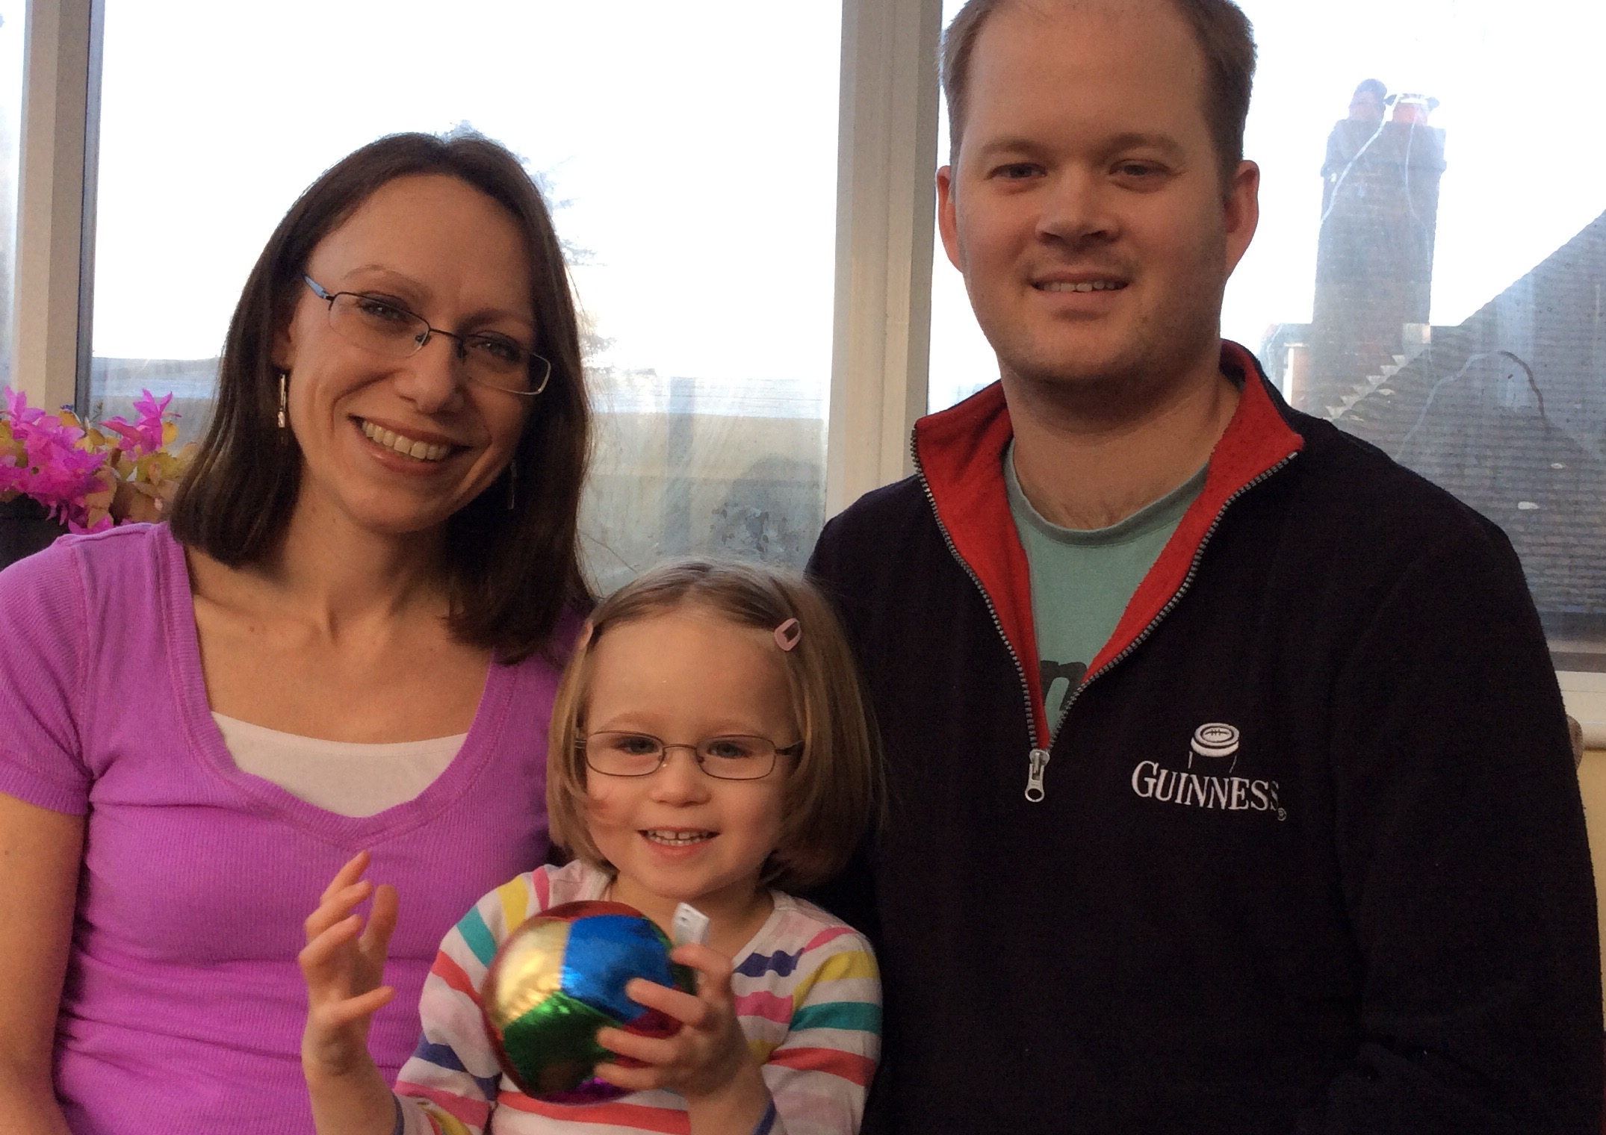
Hundred Thousand Genome Project: Jessica Wright
Notes:
1:00 [2:30/20:00]
This is Kate, Simon, and the adorable one in the middle is their daughter Jessica, who is 4 years old. When Jessica was born, everything had gone really well and Jessica seemed to be developing fine until she was coming up to about 13 months. Kate and Simon noticed that Jessica wasn’t moving around as much as other children her age and she started having seizures, so of course Kate and Simon wanted to know what was going on.
Now it turns out that Jessicca has a rare disease called GLUT1 Deficiency Syndrome which means her brain isn’t getting enough energy, which can be controlled by a special diet, but of course that requires actually getting a diagnosis. In the case of rare diseases like this, the average patient has 3 incorrect diagnoses and it takes an average of 4 years to get their final correct diagnosis.
After what seemed like endless tests, including things like MRI scans, lumbar punctures, EEGs, doctors were no closer to a diagnosis, but luckily, via a support network, Kate and Simon were put in touch with the hundred thousand genome project, and via a really simple test – a blood sample each from Jessica and her parents – they were able to get their genomes mapped, and which allowed doctors to pinpoint the exact condition Jessicca had.
Now obviously this was a massive relief for Kate and Simon because now they knew what the problem was, Jessica’s symptoms could be managed. They also found out that the syndrome was caused by a spontaneous gene mutation rather than inherited, so that means if they have another child later, it’s highly unlikely that they’ll be affected by the same condition.
https://www.gosh.nhs.uk/news/latest-press-releases/first-children-receive-genetic-diagnosis-gosh-part-100000-genomes-project

Slide 3
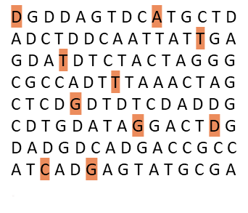
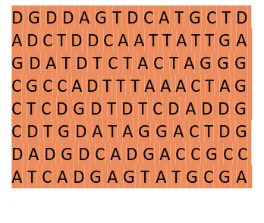
First Full Genome Sequenced in 2003
Previously
Now
Faster and cheaper
Over 10 years … 1 day
Over £1,000,000,000 … less than £1,000
Notes:
1:00 [3:30/20:00]
So, in essence, that is what the 100,000 genomes project is about. In terms of the science behind it, I won’t go into too many details, but in short:
A person's genome is every single gene or bit of DNA in their body. Scientists have been able to sequence DNA since the 1970s, but it used to be just 5% of the genes that were looked at and the other 95% were discarded. Since 2003 full genome sequencing has been available. The first time is was done, it took over 10 years and cost over $2bn but now it can be done in a day and costs less than $1000. It has 2 applications; rare diseases and cancer. Whole genome sequencing can enable rapid diagnosis in people with rare disease, and whole genome sequencing of tumour tissue can inform selection of treatments for cancer.
The hundred thousand genome project was set up by the UK government with the aim of sequencing 100K genomes from patients with rare diseases and cancer. It reached its target of 100,000 genomes last month but analysis of all the results is still ongoing.

Slide 4
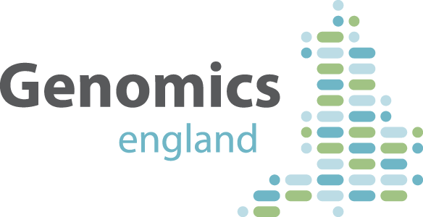

National Genomics Medicine Service
National genomic lab service via network of hubs
Being rolled out to the NHS in 2019
National Genomics Test Directory
NHS first in the world to offer this
Notes:
0:30 [4:00/20:00]
Following the 100,000 genomes project, is the creation of the NHS Genomic Medicine Service. The National Health Service in the UK is going to be the first public healthcare system in the world to offer a Genomics Medicine Service to its patients, where patients can be referred to their nearest genomics medicine clinic, and clinicians can order different genetic tests for its patients.
This is all being done by Genomics England, who are a company owned by the Department of Health and Social Care, and we, Elucidata, are one of the companies that they work with to deliver this service.

Slide 5
Case Pipeline
Clinic
UK Biobank
Illumina
GEL Bioinformatics
Clinical Interpretation Partners
Clinical Report Sent
DNA Extracted
Further analysis
DNA Stored in national biorepository
Results analysed
DNA Sequenced
Notes:
0:30 [4:30/20:00]
# Tech 1: Original app/portal (4 mins ~500 words)
[224 words]
[say it at an increasing speed to convey the complexity, and slow right down when you get to “ultimately…”
But, it’s not just the actual genomic data which is important. Sequencing the genome is actually the fast part of the process. There’s a pretty large sequence of events and analyses which need to happen to from blood sample to final report. A patient’s DNA is extracted at hospital, sent to a sequencing centre and biorepository, sent to Genomics England, the hospital sends health data which is analysed together with DNA report to Genomics England, analysed by scientists to find commonalities and patterns between different people, and send report back to hospital care team for the individuals,
So we we’re talking about data from multiple organisations with really complex processes that have a lot of people working on them, with vast amounts of metadata which needs managing. We’ve got people with all sorts of different jobs, so like the samples team, lab technicians, bioinformaticians, program managers, clinicians, who all need to interact with this metadata, and the metadata comes from different software, different databases, with different business rules and quality controls applied to it but ultimately needs to be brought together in some sort of unified platform without the end user having to deal with all of this complexity.
So, that’s where Shiny comes in. We used Shiny to create an application called the management information portal, which clinicians used to a number of different reports.

Slide 6
R Packages
Core Packages
Look & Feel
htmlwidgets
shiny
tidyverse
DBI
httr
shinyjs
shinydashboard
shinycssloaders
shinyBS
shinyalert
shinyWidgets
kableExtra
plotly
DT
sunburstR
visNetwork
timevis
listviewer
Notes:
0:30 [4:30/20:00]
# Tech 1: Original app/portal (4 mins ~500 words)
[224 words]
[say it at an increasing speed to convey the complexity, and slow right down when you get to “ultimately…”
But, it’s not just the actual genomic data which is important. Sequencing the genome is actually the fast part of the process. There’s a pretty large sequence of events and analyses which need to happen to from blood sample to final report. A patient’s DNA is extracted at hospital, sent to a sequencing centre and biorepository, sent to Genomics England, the hospital sends health data which is analysed together with DNA report to Genomics England, analysed by scientists to find commonalities and patterns between different people, and send report back to hospital care team for the individuals,
So we we’re talking about data from multiple organisations with really complex processes that have a lot of people working on them, with vast amounts of metadata which needs managing. We’ve got people with all sorts of different jobs, so like the samples team, lab technicians, bioinformaticians, program managers, clinicians, who all need to interact with this metadata, and the metadata comes from different software, different databases, with different business rules and quality controls applied to it but ultimately needs to be brought together in some sort of unified platform without the end user having to deal with all of this complexity.
So, that’s where Shiny comes in. We used Shiny to create an application called the management information portal, which clinicians used to a number of different reports.

Slide 7
App Design Priorities
To create an app that could be used by people across the project
For each dashboard to answer a small subset of questions well
Fast iterations and featured additions
Notes:
The main priorities for the app were:
To create one app that could be used by people across the project
For each dashboard to answer a small subset of questions well
Fast iterations and featured additions
So let’s take a look now at the portal and a few different ways of using it.

Slide 8
Program Manager at Genomics England
How close are we to the 100,000 genomes target?
How many of these come from patients with cancer or rare diseases?
How do our metrics break down by stage of the process?
Where are samples getting stuck in the pipeline and how does this vary by clinic?
Notes:
The main priorities for the app were:
To create one app that could be used by people across the project
For each dashboard to answer a small subset of questions well
Fast iterations and featured additions
So let’s take a look now at the portal and a few different ways of using it.

Slide 9
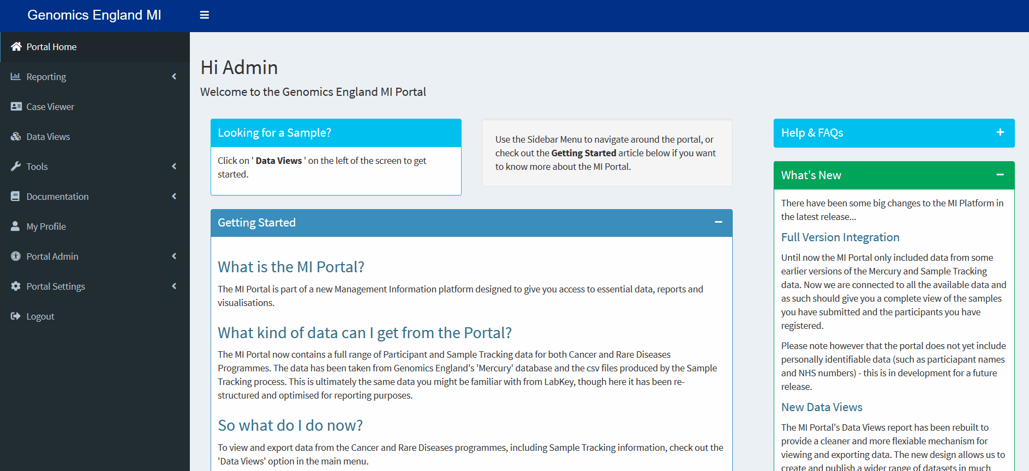
MIS Portal
Notes:
1:20 [6:50/20:00]
# Tech 1: Original app/portal (4 mins ~500 words)
[1 minute 20 seconds]
OK, so we’ve made a version of the app which has been loaded with some dummy data here.
So let’s say for example I was a programme manager and wanted to look at how the genomic medicine clinics in different areas were doing, I could access the operations dashboard, as shown here. So there’s a load of different metrics there, and we can change the time period we’re looking at, but what if we want to see this as a visualisation? Well there’s this thing here, called a sunburst chart, made with htmlwidgets, and so I can select a few clinics and use this to see how many cases are at different stages of the process.

Slide 10
Sample Team in Lab
Flag up problem with the sample
What are the other related samples in the case hierarchy?
Has this sample been flagged before?
Notes:
1:20 [6:50/20:00]
# Tech 1: Original app/portal (4 mins ~500 words)
[1 minute 20 seconds]
OK, so we’ve made a version of the app which has been loaded with some dummy data here.
So let’s say for example I was a programme manager and wanted to look at how the genomic medicine clinics in different areas were doing, I could access the operations dashboard, as shown here. So there’s a load of different metrics there, and we can change the time period we’re looking at, but what if we want to see this as a visualisation? Well there’s this thing here, called a sunburst chart, made with htmlwidgets, and so I can select a few clinics and use this to see how many cases are at different stages of the process.

Slide 11

MIS Portal
Notes:
1:00 [7:50/20:00]
# Tech 1: Original app/portal (4 mins ~500 words)
1 minute
Another example is that I could be a lab technician who’s found a problem with one of the samples I’ve been analysing and I need to report this.
So I access the processing flag tool here, and search for the case.
This then brings up the entire case hierarchy, so which clinic and which participant the sample came from, and I can pick which bit I want to edit by clicking on it here.
Once I do that it, that brings up the history, in this case, there’s no metadata and then I can update it,
So here, oops, I forgot to enter a reason, so now I’m reminded that I need to fill that in, and then finally I can properly update that sample with the relevant flag and comment.

Slide 12
Scaled Up Application
Notes:
# Tech 2: Scaled app (5-6 mins ~625-750 words)
2:00 [10:00/20:00]
[246 words]
So that's the app that was successfully developed and rolled out for the hundred thousand genome project, and we're basically taking the best bits of it and some other pieces for the National Genomic Medicine Service version. This time though it’s being rolled out across the entire country and so the new version needs to support hundreds, possibly thousands of concurrent users.
As with any live project, I originally intended to show you the scaled up version, but we’re still finalising some of the details of it at the moment. However, what I can share with you are the key things we learned during the process of scaling up the application.

Slide 13
How did we scale the app?
Horizontally and vertically
Realistic user paths
Use profvis and shinyloadtest
Notes:
1:20 [6:50/20:00]
# Tech 1: Original app/portal (4 mins ~500 words)
[1 minute 20 seconds]
OK, so we’ve made a version of the app which has been loaded with some dummy data here.
So let’s say for example I was a programme manager and wanted to look at how the genomic medicine clinics in different areas were doing, I could access the operations dashboard, as shown here. So there’s a load of different metrics there, and we can change the time period we’re looking at, but what if we want to see this as a visualisation? Well there’s this thing here, called a sunburst chart, made with htmlwidgets, and so I can select a few clinics and use this to see how many cases are at different stages of the process.

Slide 14
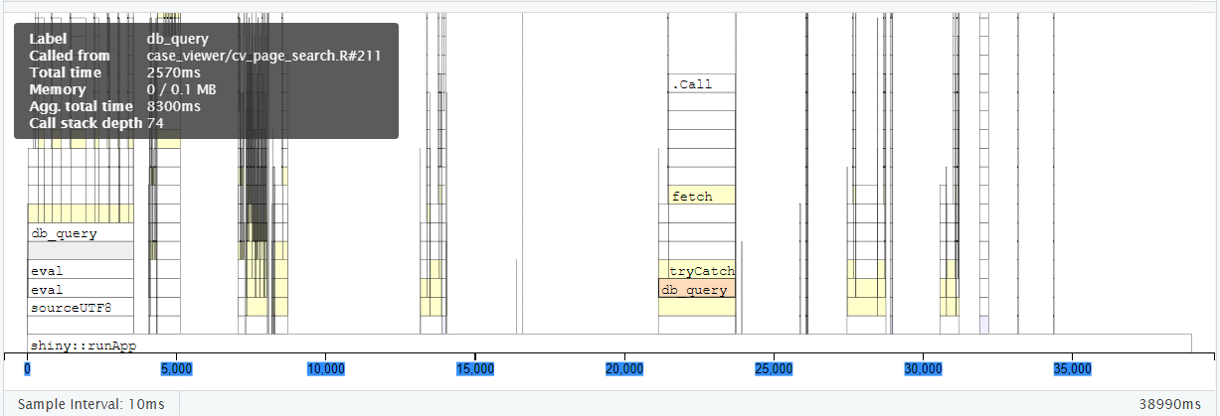
profvis: Finding our Watermelons
Database calls
API call
Notes:
So firstly, here’s a screenshot from profvis. So the x axis is time, and what I really love about this is that in the actual version of this you can hover over the different bits to see all the subcomponents.
If you look at some past talks by Joe Cheng on using async, one metaphor he uses is that you need to pick off watermelons, and not blueberries. In other words, pick the big expensive operations, because if you make everything asynchronous, you’ll just slow your app down overall.
I was quite pleased to find that it was really just the database and API calls that were slowing things down in individual sessions, so that confirmed to us that we didn’t really need to make any substantial changes to our code.

Slide 15
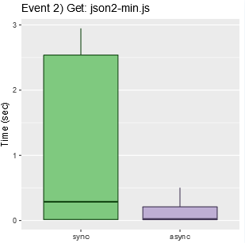
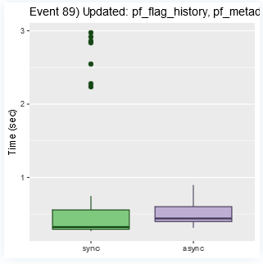
shinyloadtest: optimising consistency
Notes:
Consistency is an important metric – even if changes don’t impact how long something takes on average, actually reducing the median for people is an important aim.
Not the median time that matters – removing outliers important too!

Slide 16

Optimise Your Shiny Code First
Don’t get hung up on making everything asynchronous
Reactive code is easier to update than imperative code
Notes:
Consistency is an important metric – even if changes don’t impact how long something takes on average, actually reducing the median for people is an important aim.
Not the median time that matters – removing outliers important too!

Slide 17
Optimise DB functions
Writing efficient SQL is important
Take advantage of advanced functionality
DB functions simplify things
Notes:
Consistency is an important metric – even if changes don’t impact how long something takes on average, actually reducing the median for people is an important aim.
Not the median time that matters – removing outliers important too!

Slide 18
Optimise Data Loading
htmlwidgets are great for interacting with data
Use careful timing to decide when/what loaded from the DB functions
Notes:
Consistency is an important metric – even if changes don’t impact how long something takes on average, actually reducing the median for people is an important aim.
Not the median time that matters – removing outliers important too!

Slide 19
Conclusions
Design decision affect the kind of scaling needed
Thinking carefully about database functions is important
Optimise for 1 user before optimizing for multiple users
Shiny is scalable
Notes:
Consistency is an important metric – even if changes don’t impact how long something takes on average, actually reducing the median for people is an important aim.
Not the median time that matters – removing outliers important too!

Slide 20

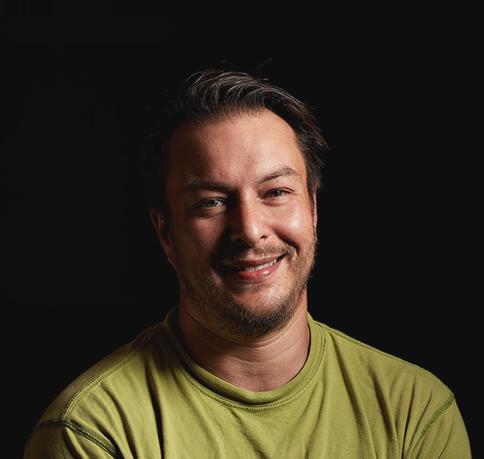

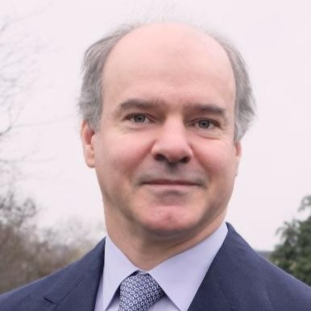
Thank You!
Nic Crane
nic.crane@elucidata.co.uk
Twitter: @nic_crane
elucidata.co.uk

